Slide 1
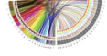
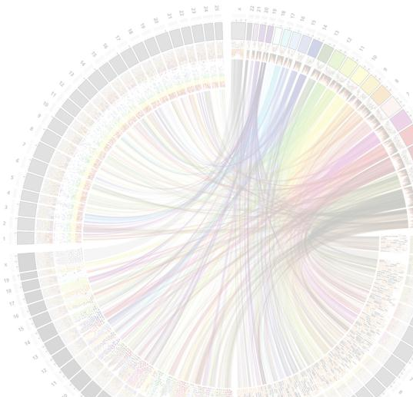


MSc in Bioinformatics
Module 4: Structure and Function of Proteins and Drug Design
Molecular Dynamics Simulations of Membrane Proteins
Nil Casajuana-Martin
Laboratory of Computational Medicine
Nil.Casajuana@uab.cat

Slide 2
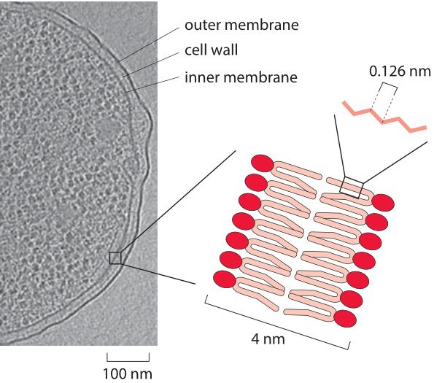
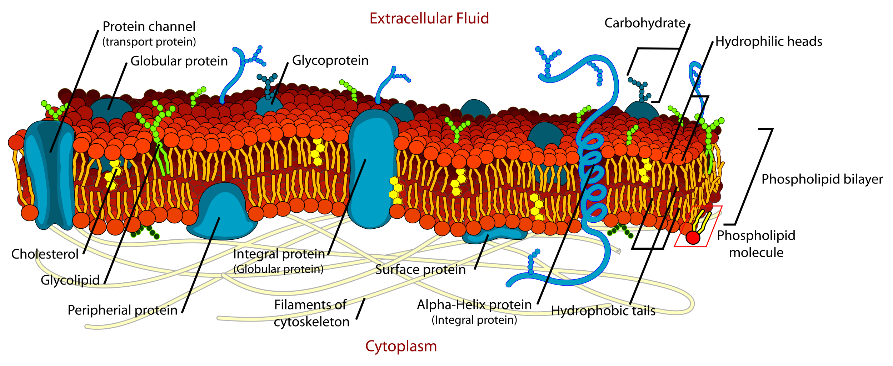
The cell membrane
- Separates the interior of all cells from the outside environment
- Phospholipid bilayer
with embedded proteins
From Mariana Ruiz, Public Domain
Adapted from A. Briegel et al. Proc. Nat. Acad. Sci., (2009)
1
Notes:
Figure 1: An electron micrograph of an E. coli cell highlighting the width of the cell inner and outer membranes and the cell wall.

Slide 3
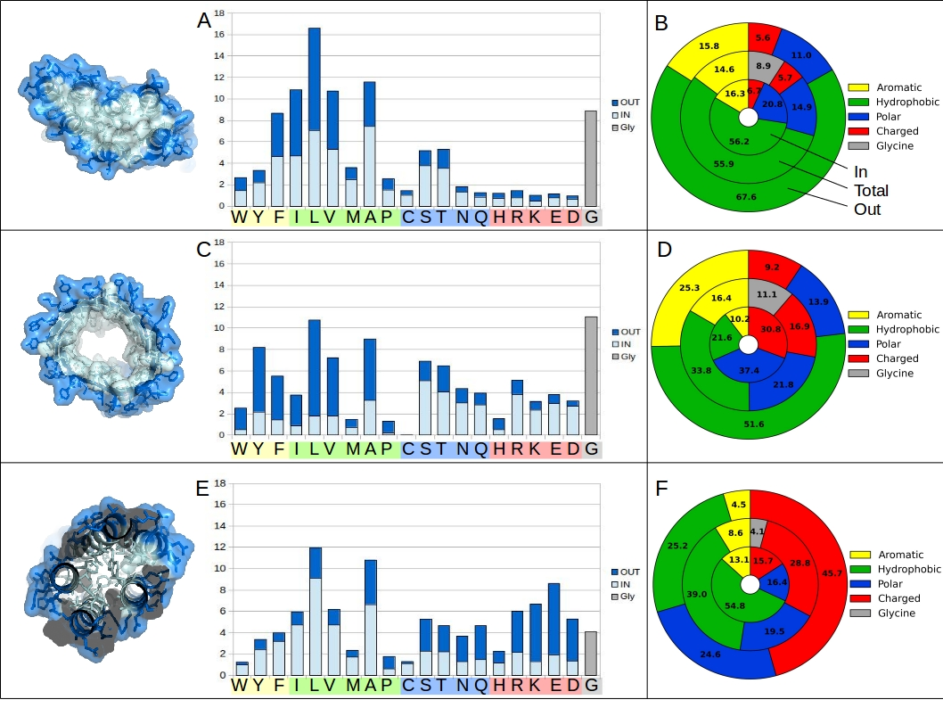
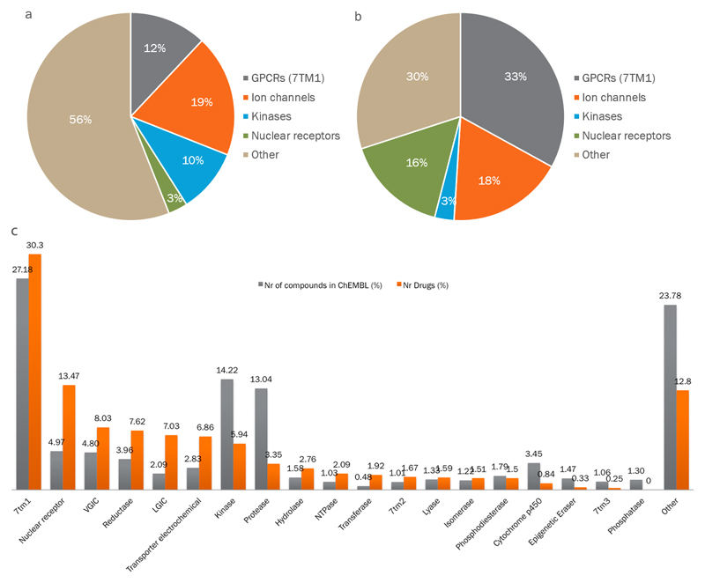
Membrane proteins
Residue composition
~30% of all genes
>50% of all drugs
TM
helix bundles
TM
β-barrels
 | Globular proteins | Membrane proteins
shape | spherical | helix bundle / β-barrel
need to | be soluble in water | cross the membrane
exterior | hydrophilic | hydrophobic
interior | hydrophobic | helix bundles: hydrophobic β-barrel: hydrophilic
globular
2
Notes:
Not gonna go over all the different protein types

Slide 4
The cell membrane
From Mariana Ruiz, Public Domain
3

Slide 5
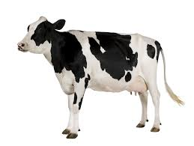
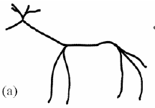
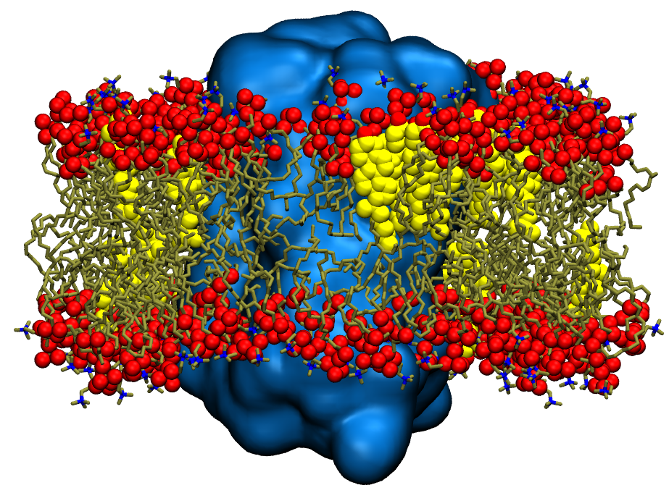
From “reality”...
... to a model
From Mariana Ruiz, Public Domain
One (or few) component phospholipid bilayer
simpler = less sampling
4

Slide 6
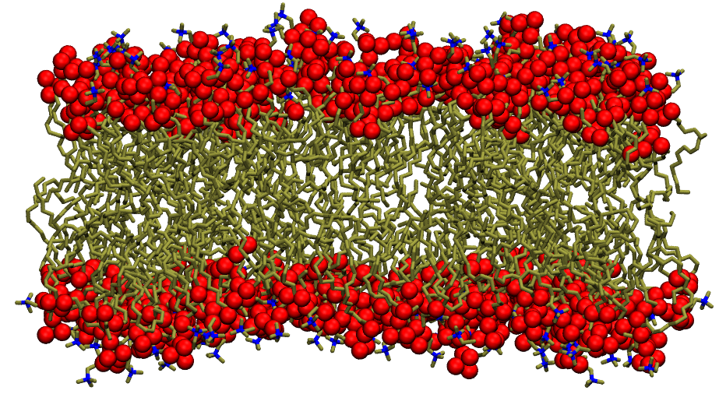
Meet the components
Phospholipid
Usually PC based
Representative lipid
Desired membrane properties
Well studied experimentally
5

Slide 7
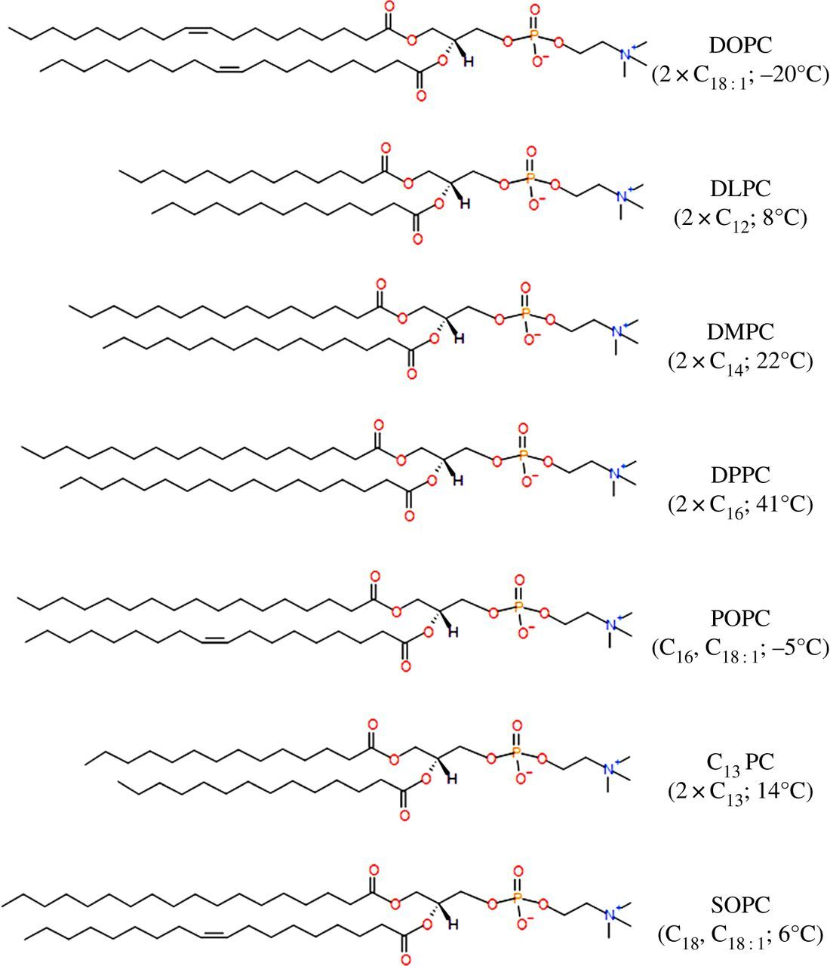
The most typical phospholipids in a membrane model
2x fatty acids
glycerol
PC
DOPC: 1-oleyl-2-oleyl-sn-glycero-phosphatidylcholine
DPPC: 1-palmitoyl-2-palmitoyl-sn-glycero-phosphatidylcholine
POPC: 1-palmitoyl-2-oleyl-sn-glycero-phosphatidylcholine
Extracted from C. Duncan et al. J R Soc Interface, (2014)
Notes:
Mention or highlight the polar head and the hydrophobic part

Slide 8
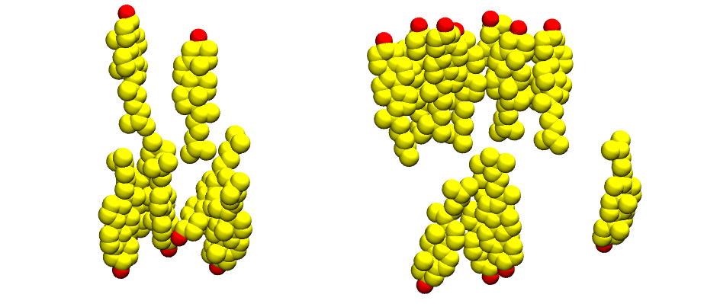
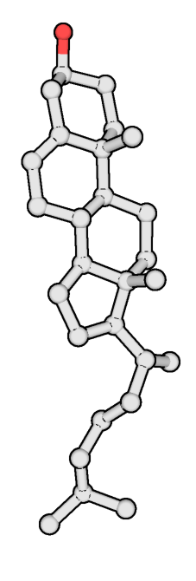
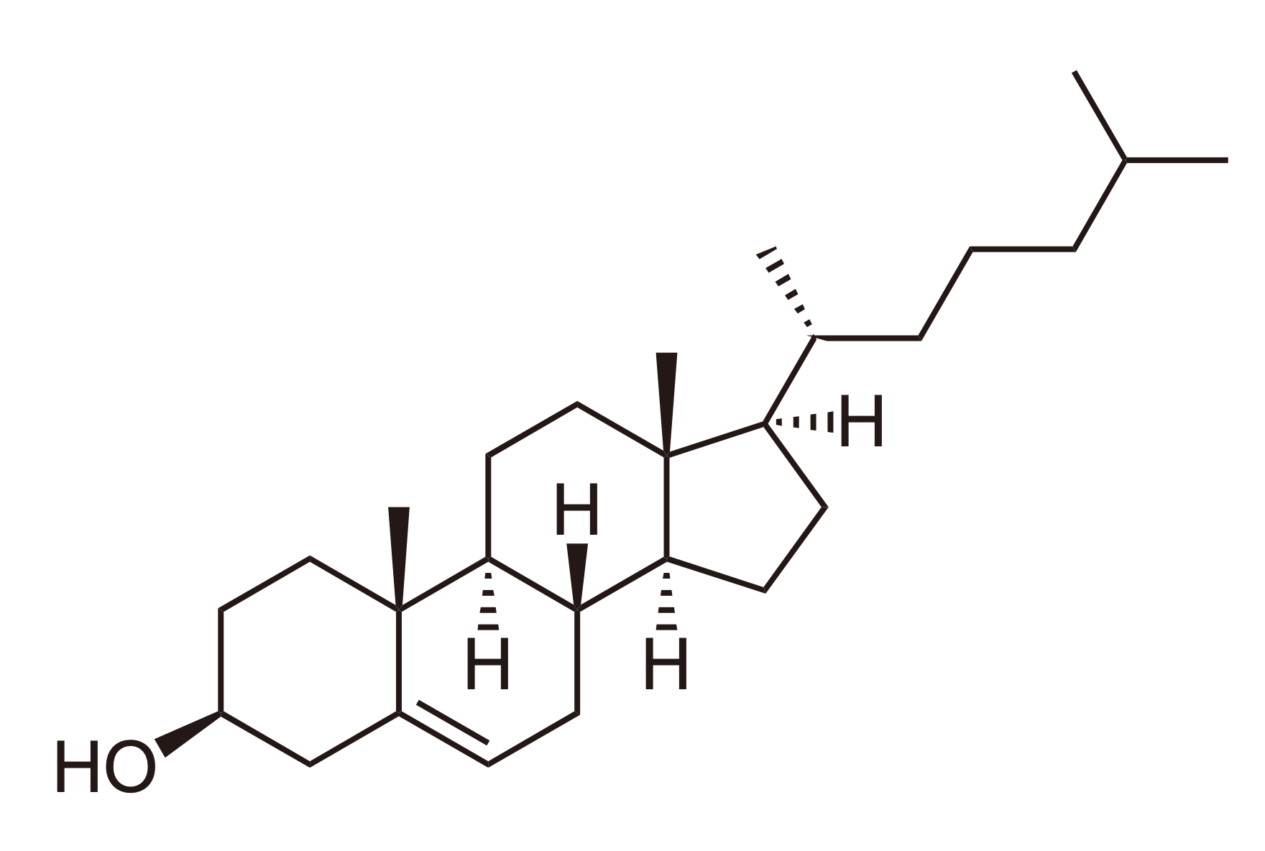
Meet the components
Phospholipid
Cholesterol
Usually PC based
Representative lipid
Desired membrane properties
Well studied experimentally
POPC or DOPC/DPPC most typical
Present in any (Eukariotic) cell membrane
Modifies membrane’s features
5
Notes:
Highlight the polar head. And it also interacts with membrane proteins.

Slide 9
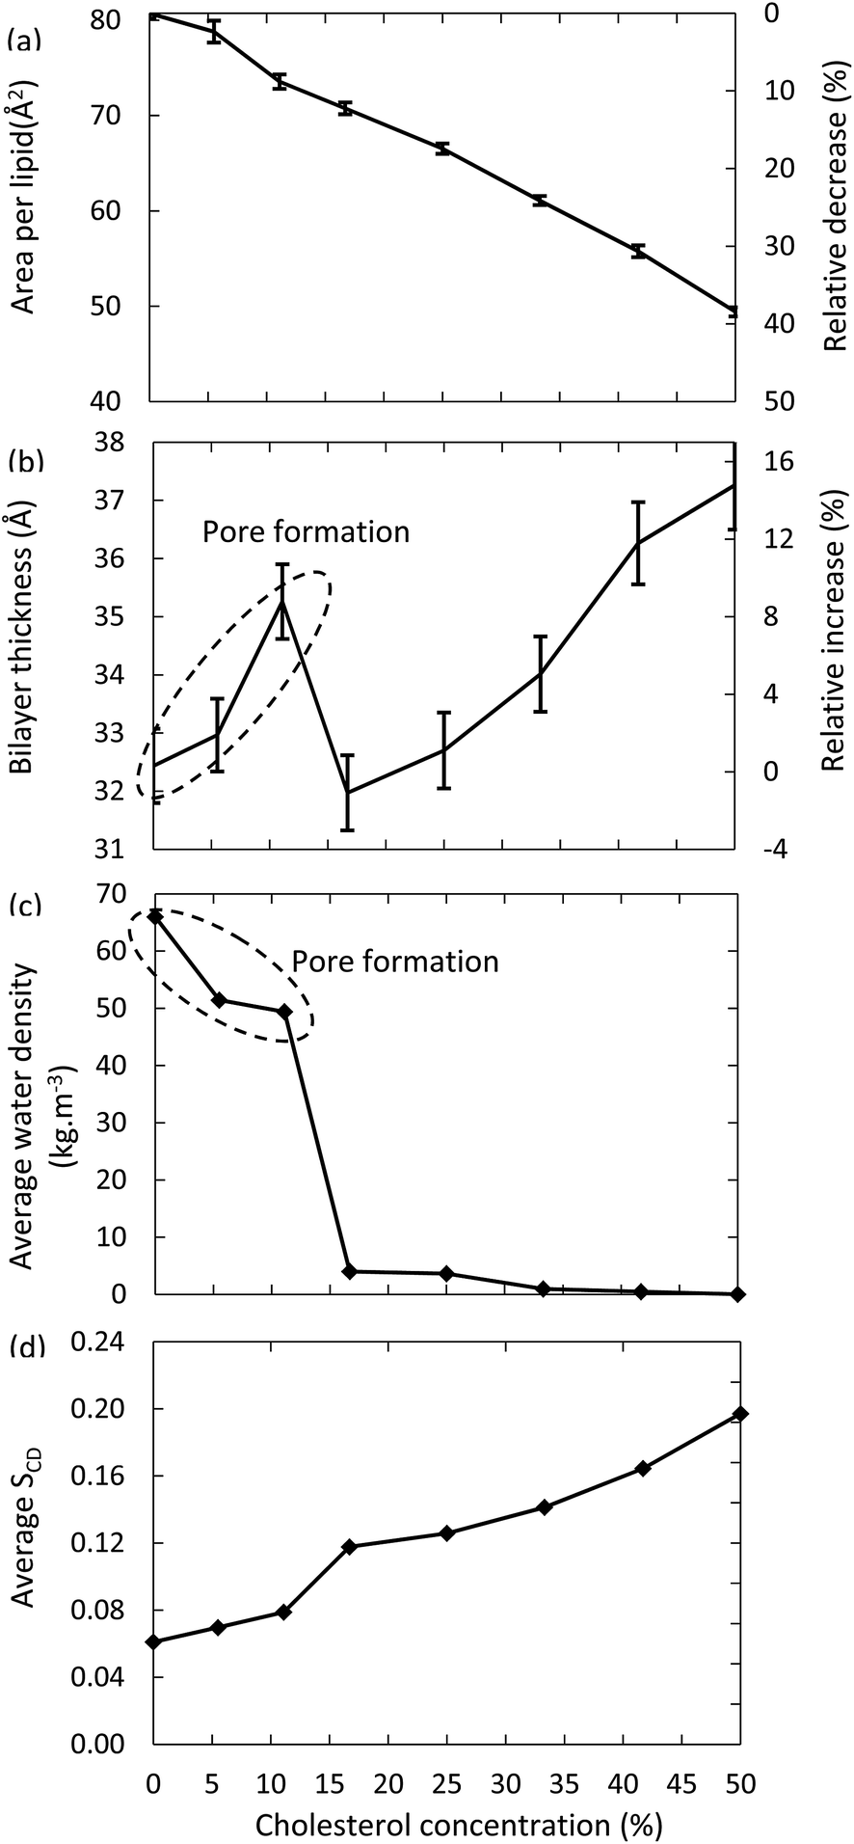
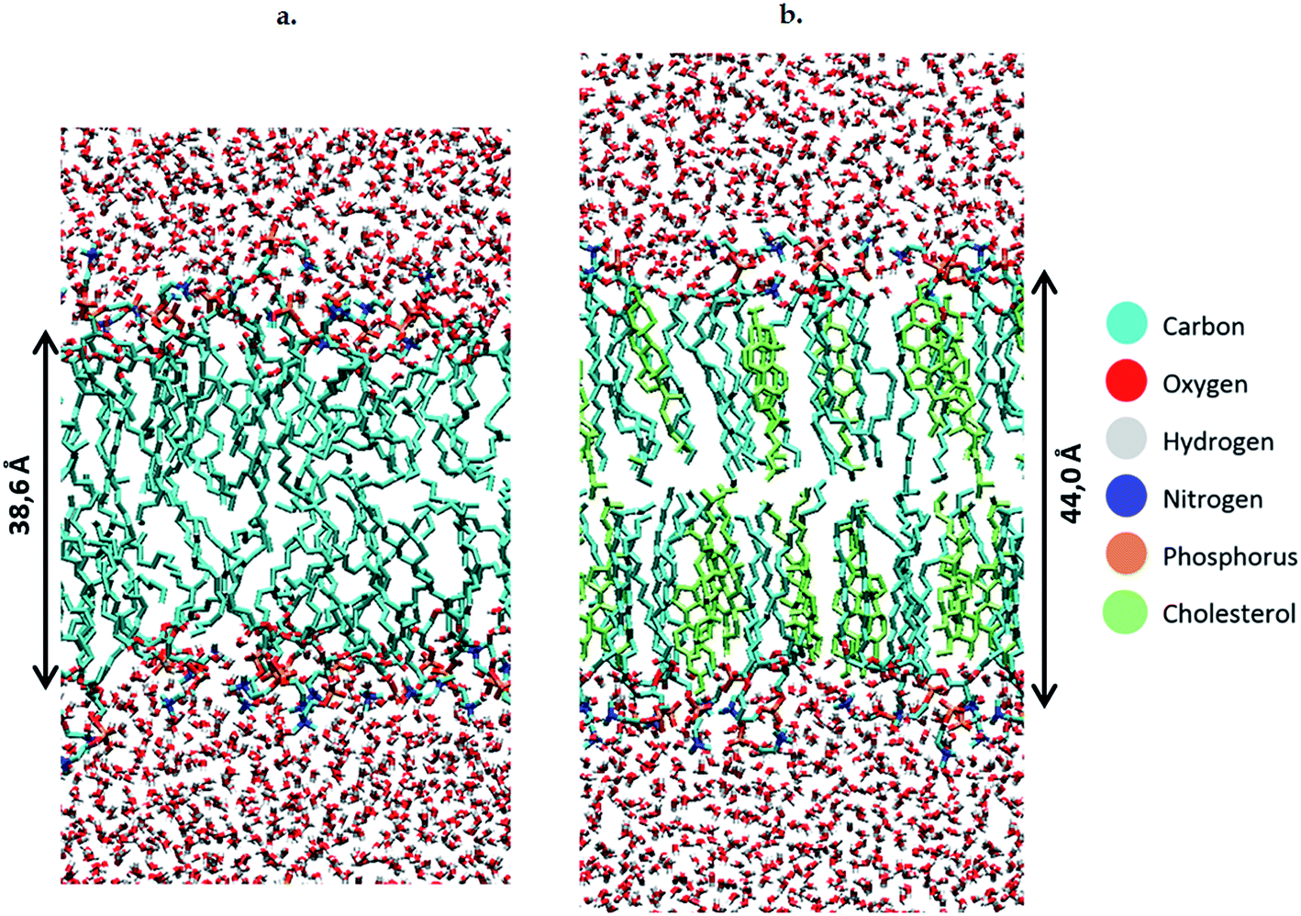
Cholesterol modifies membrane’s features
From J. Van der Paal et. al. Chem. Sci. (2016)
6
Notes:
Highlight the polar head. And it also interacts with membrane proteins.

Slide 10
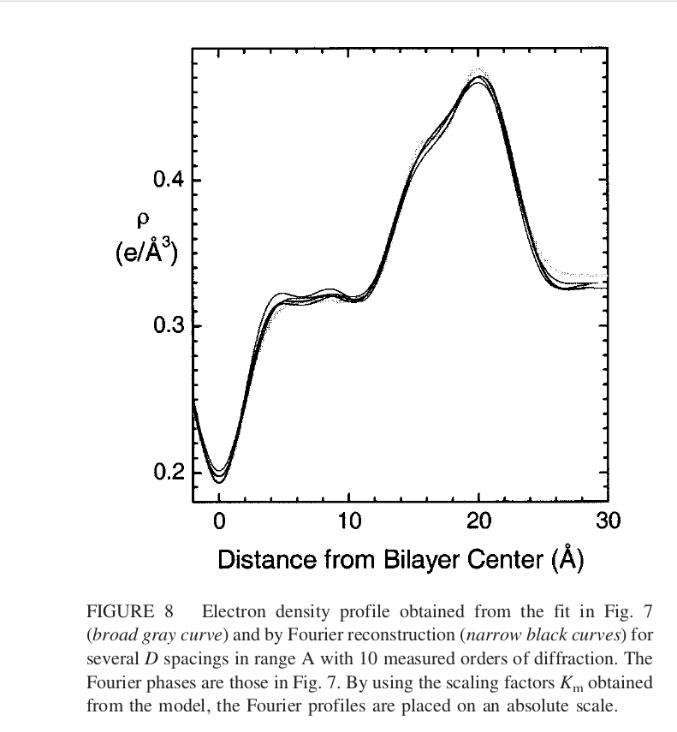
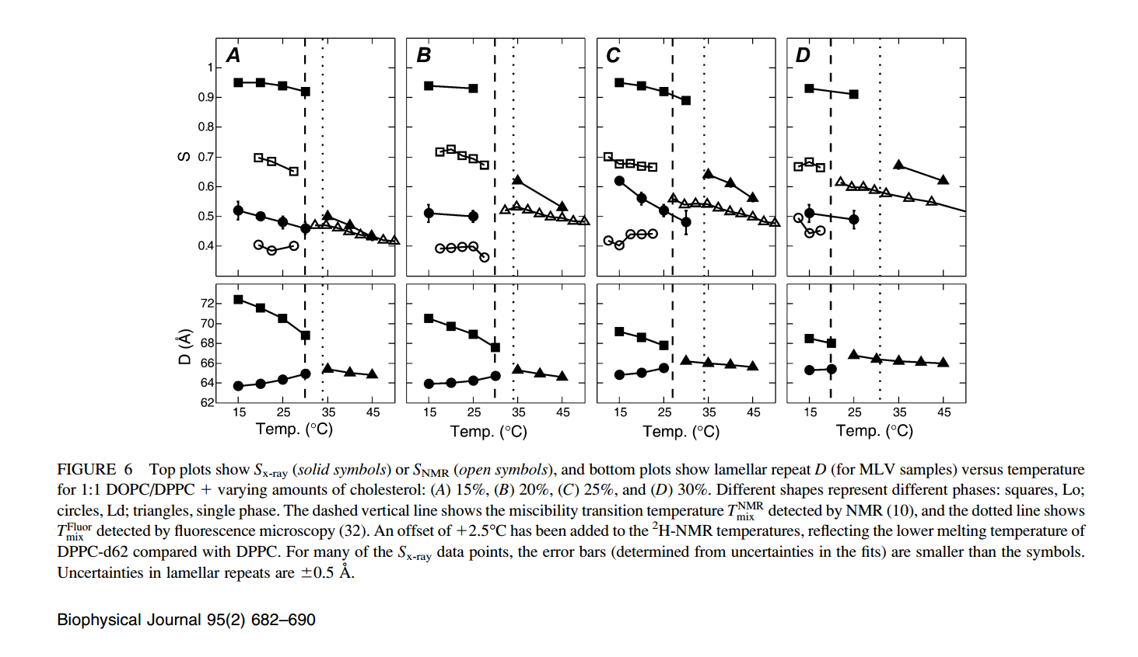
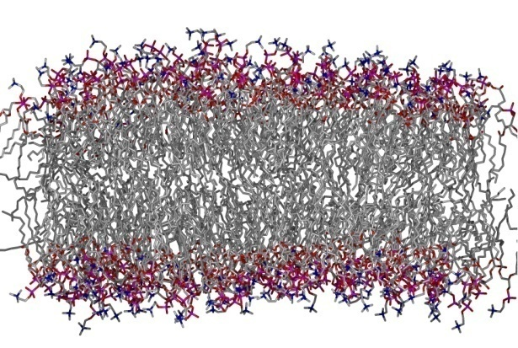
From “reality”...
... to a model
From experiments
to Force Fields
(x-rays, neutron scattering, solid state NMR)
(dihedrals, Lennard-Jones, charges…)
7
Notes:
From the experiments to FF parameters

Slide 11
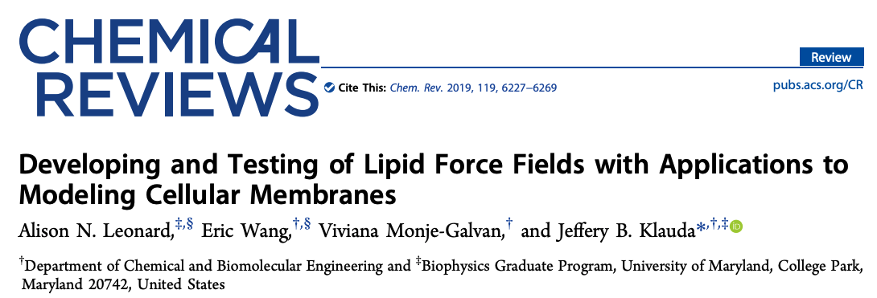
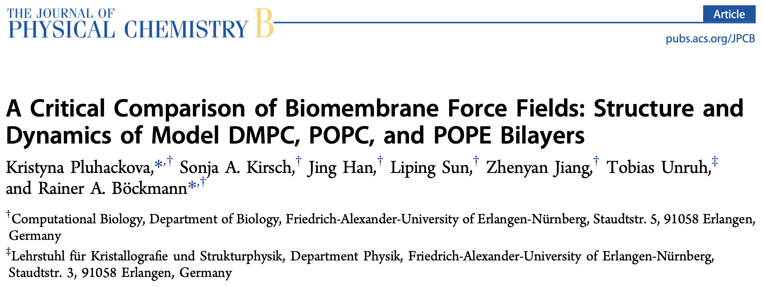
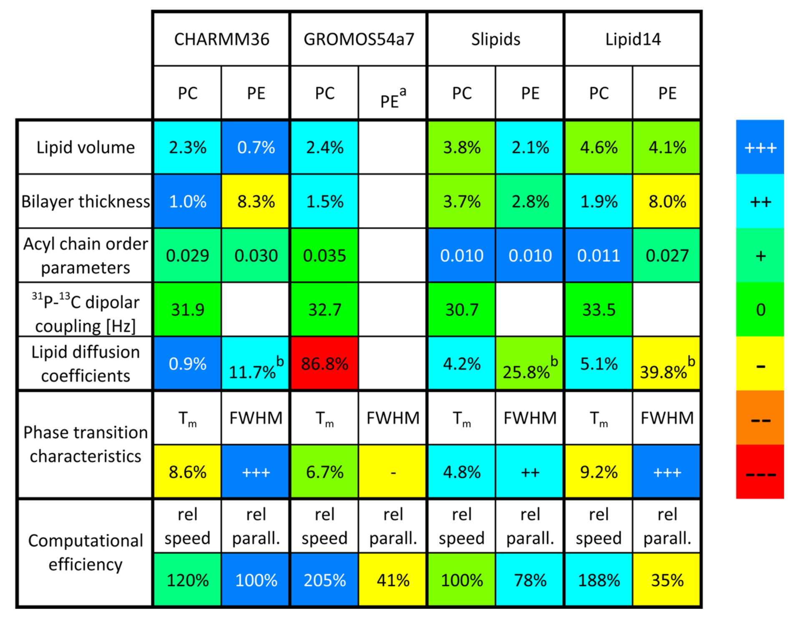
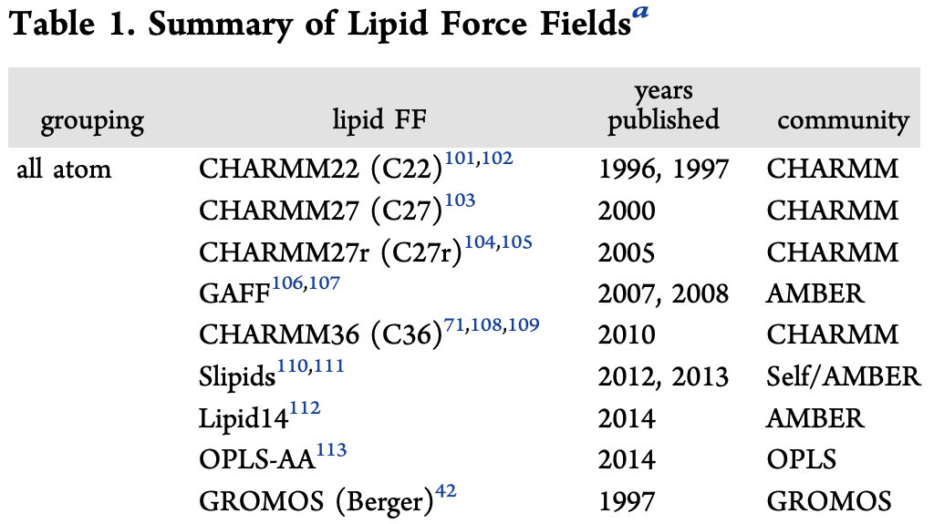
Lipid (All-atom) Force Fields
8
Notes:
Again and as in with other FF, the choice of lipid FF is not a straightforward decision.
Berger lipids also high performance because of less atom number
Charmms are by default from CHARMM-GUI membrane builder (explained in the next class)
We’re using Lipid14 in this lecture:
Really nice performance
Quite new and very well tested
Compatible with our simulator

Slide 12
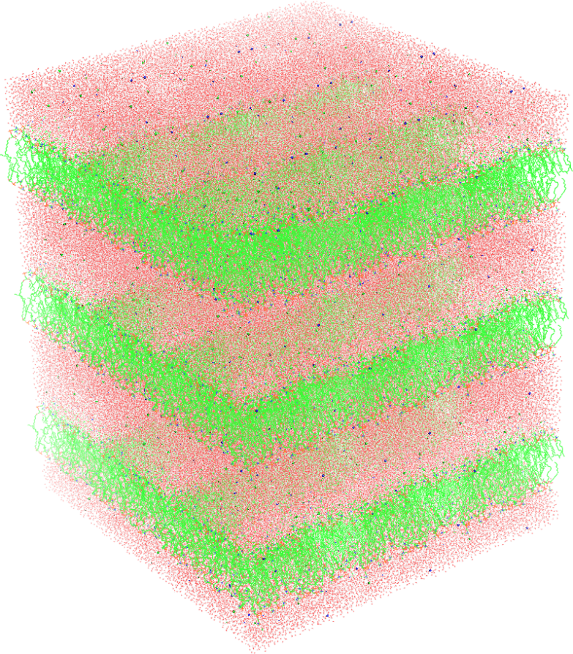
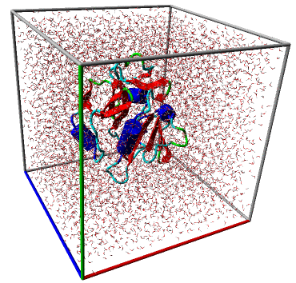
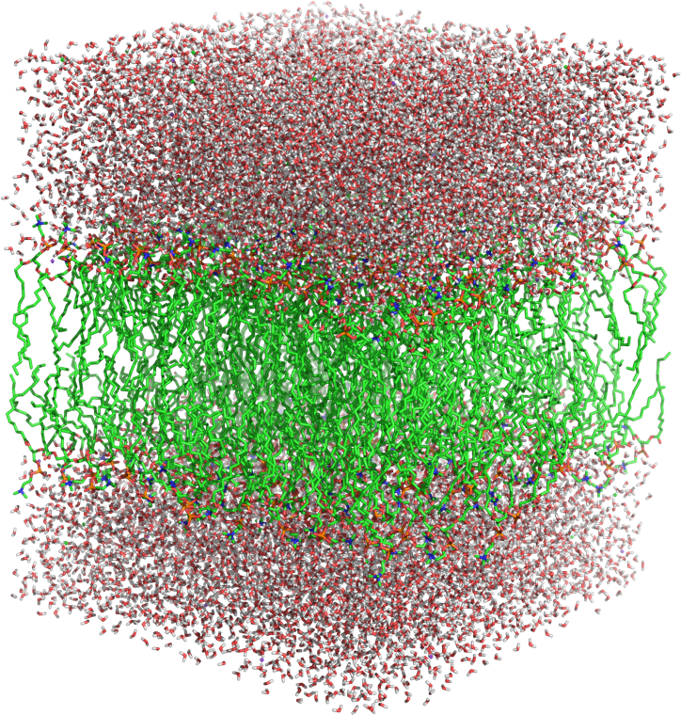
Considerations
z
x
y
isotropic
semi-isotropic / anisotropic
9
Notes:
Now we have chosen our lipid FF, what do we have to take into account when simulating…

Slide 13
Today...
Membrane-only system
Just POPC
POPC+CHL
Comparative analysis
Protein-membrane system
CB₂ in a POPC+CHL membrane
10

Slide 14
Today...
Membrane-only system
Just POPC
Membrane creation
Obtaining the parameters
Energy minimization + equilibration
Simulation
Membrane analysis
POPC+CHL
Comparative analysis
Protein-membrane system
CB₂ in a POPC+CHL membrane
PACKMOL-Memgen
11

Slide 15
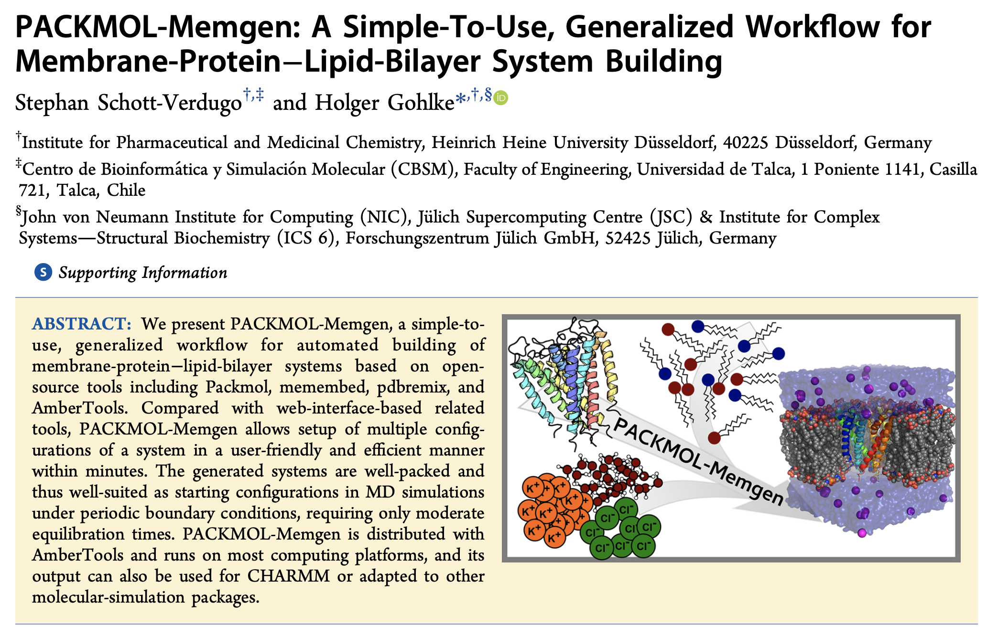
The software: PACKMOL-memgen
The builder
12
Notes:
Combination of softwares created by amber team or amber-related

Slide 16
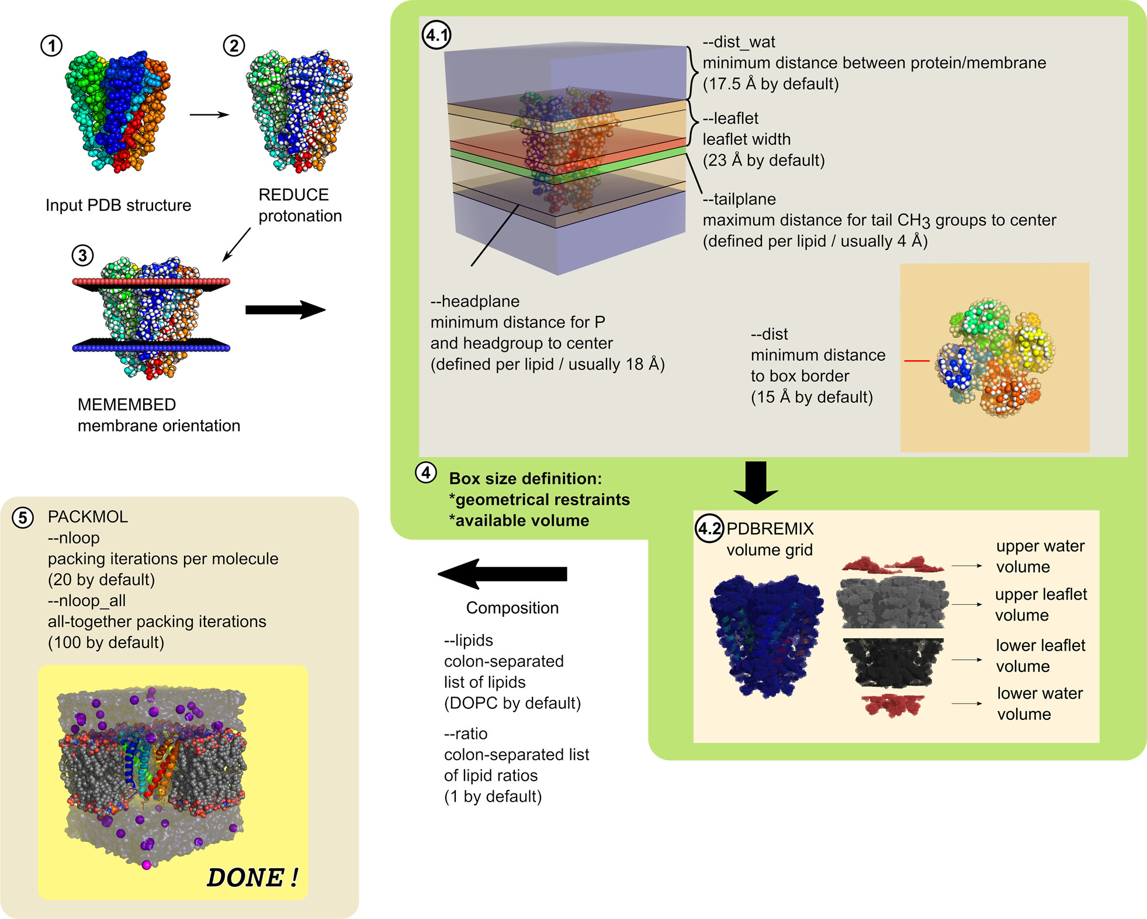
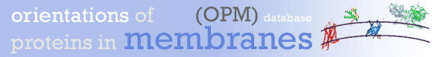
The software: PACKMOL-memgen
The builder
Membrane-only systems
Protein-membrane systems
https://opm.phar.umich.edu/
13
Notes:
Enter link and show example

Slide 17
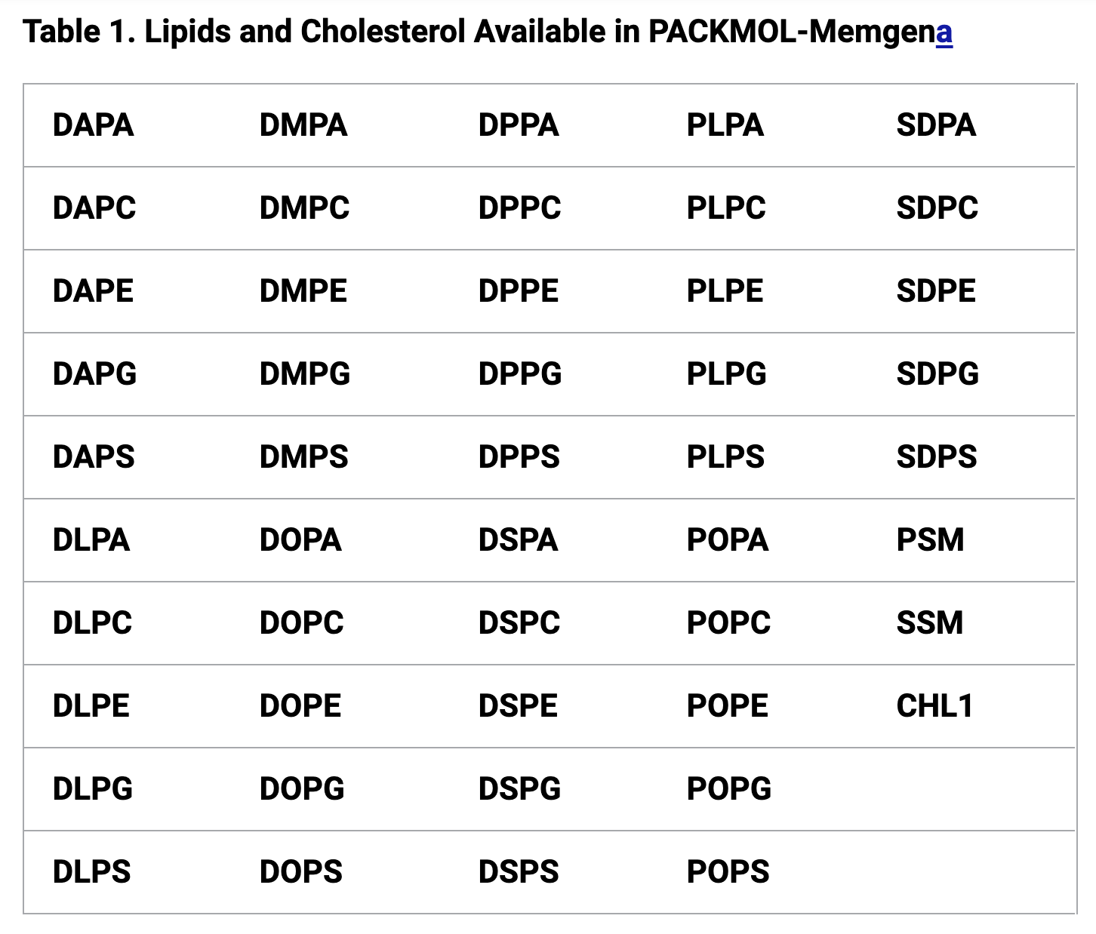
The software: PACKMOL-memgen
The builder
Membrane-only systems
Protein-membrane systems
14
Notes:
Combination of softwares created by amber team or amber-related

Slide 18
The software: PACKMOL-memgen
The builder
Membrane-only systems
Protein-membrane systems
15
Notes:
Combination of softwares created by amber team or amber-related

Slide 19
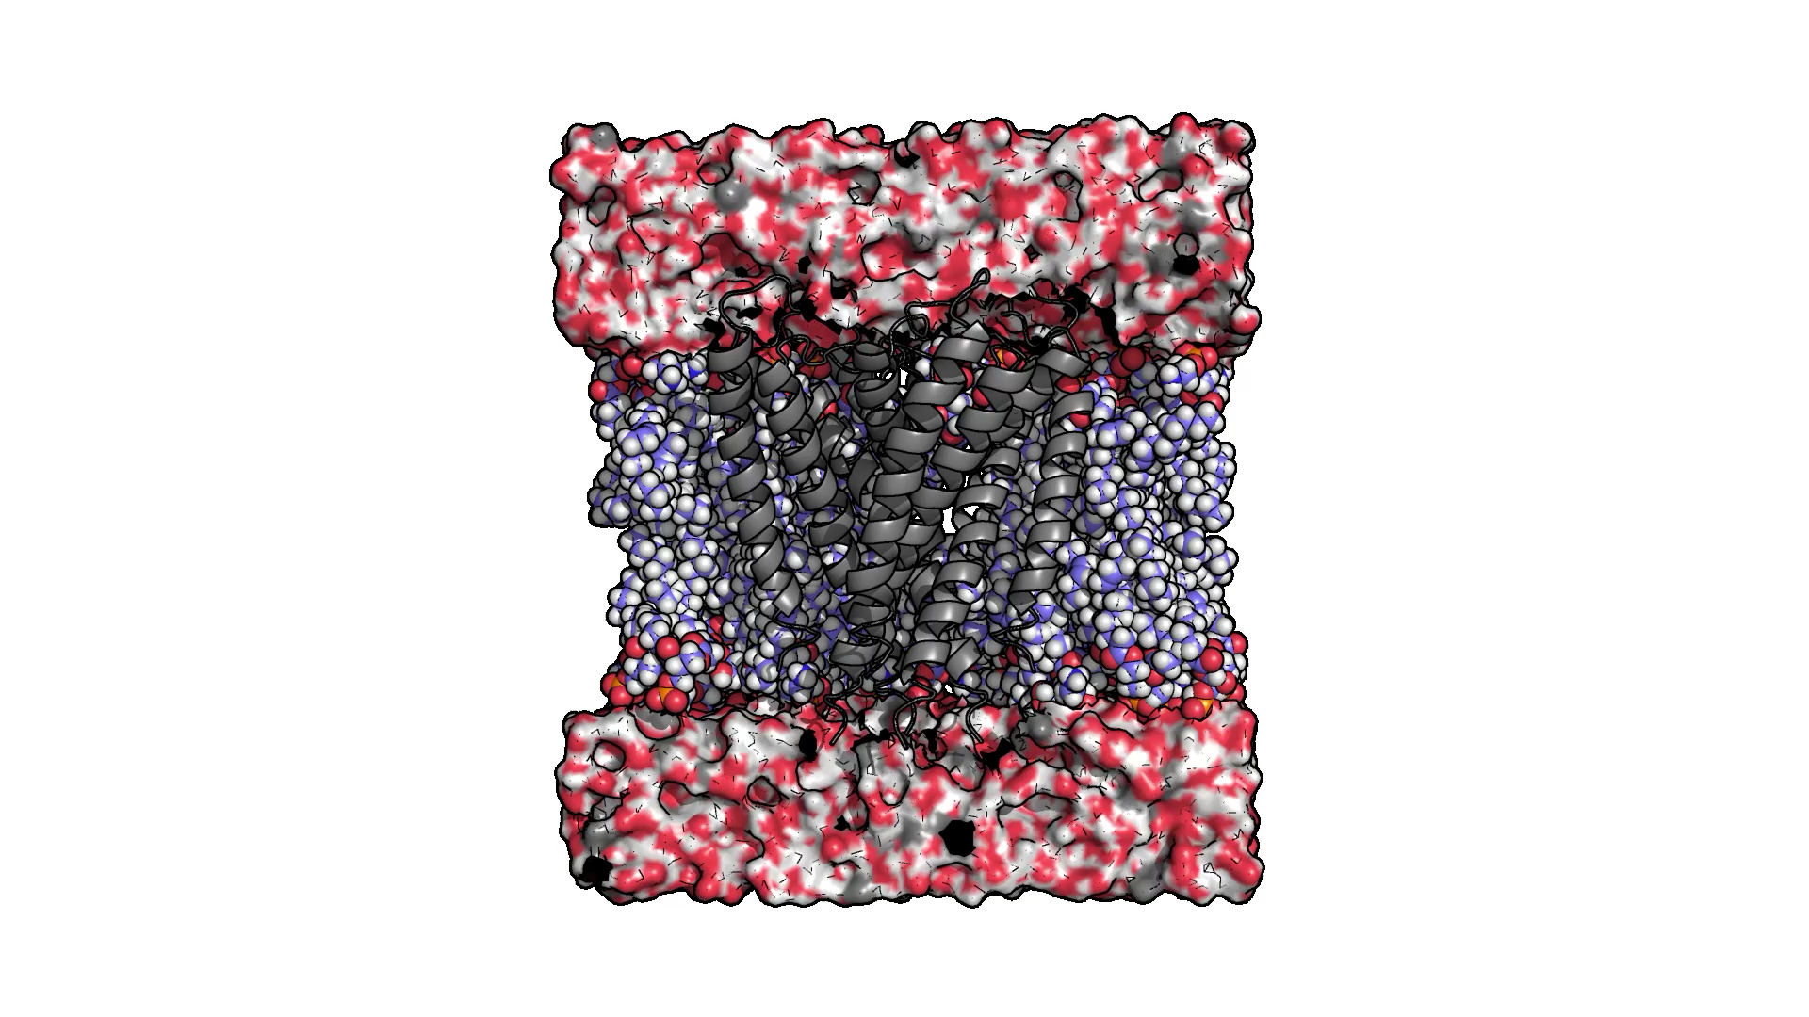
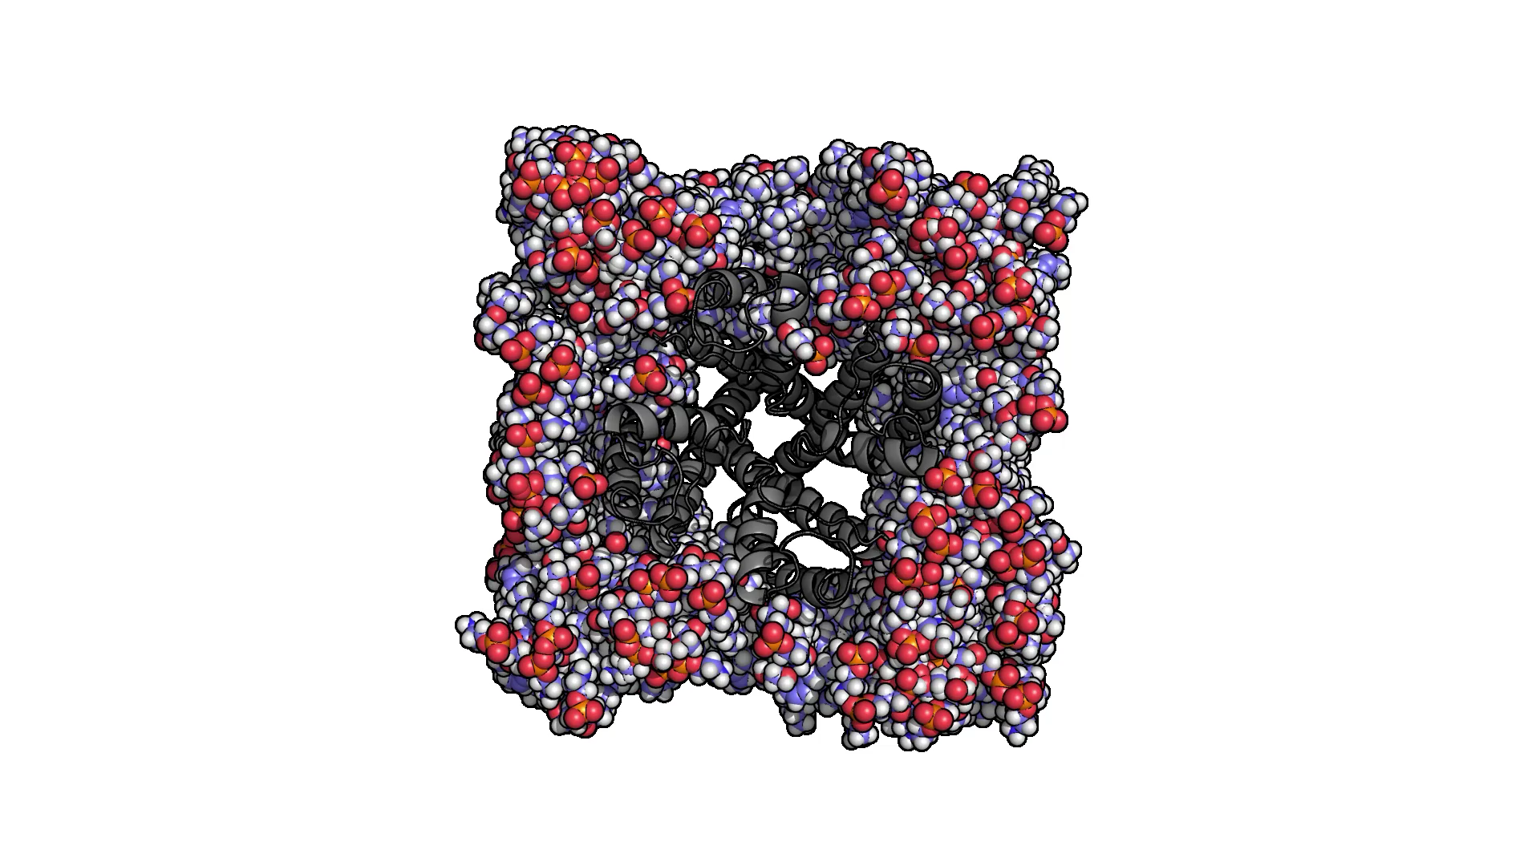
The software: PACKMOL-memgen
The builder
Membrane-only systems
Protein-membrane systems
16
Notes:
Combination of softwares created by amber team or amber-related

Slide 20

Today...
Membrane-only system
Just POPC
Membrane creation
Obtaining the parameters
Energy minimization + equilibration
Simulation
Membrane analysis
POPC+CHL
Comparative analysis
Protein-membrane system
CB₂ in a POPC+CHL membrane
PACKMOL-Memgen
17

Slide 21
The software: GROMACS
The simulator
Fast Flexible Free
(One of the) Best for membrane systems
18

Slide 22
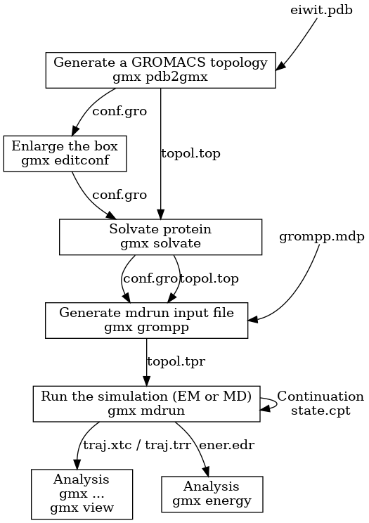
The software: GROMACS
The simulator
Fast Flexible Free
(One of the) Best for membrane systems
GROMACS flow
Coordinates (in GROMACS format)
”Topology” file (actually FF parameters)
EM/MD setup options
Input mdrun file
”Checkpoint” file
Trajectory files
Run’s variables
(Energies, pressure, temperature, density…)
From GROMACS documentation
19

Slide 23
The software: GROMACS
The simulator
Fast Flexible Free
(One of the) Best for membrane systems
GROMACS flow
PACKMOL-memgen
min.mdp → minimization
equi*.mdp → equilibration
transformation
(from AMBER to GROMACS)
prod.mdp → production (MD)
Also with FATSLiM…
From GROMACS documentation
20

Slide 24
Today...
Membrane-only system
Just POPC
Membrane creation
Obtaining the parameters
Energy minimization + equilibration
Simulation
Membrane analysis
POPC+CHL
Comparative analysis
Protein-membrane system
CB₂ in a POPC+CHL membrane
PACKMOL-Memgen
FATSLiM
21

Slide 25
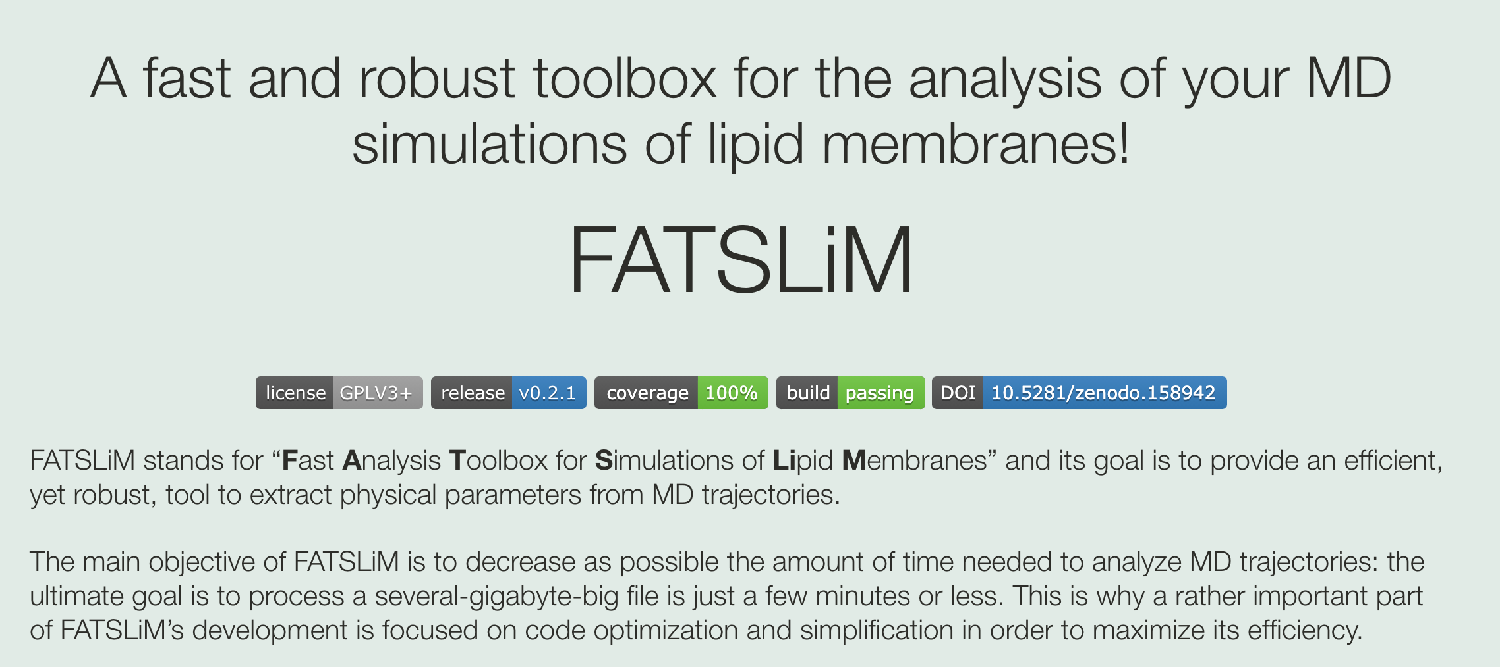
The software: FATSLiM
22

Slide 26
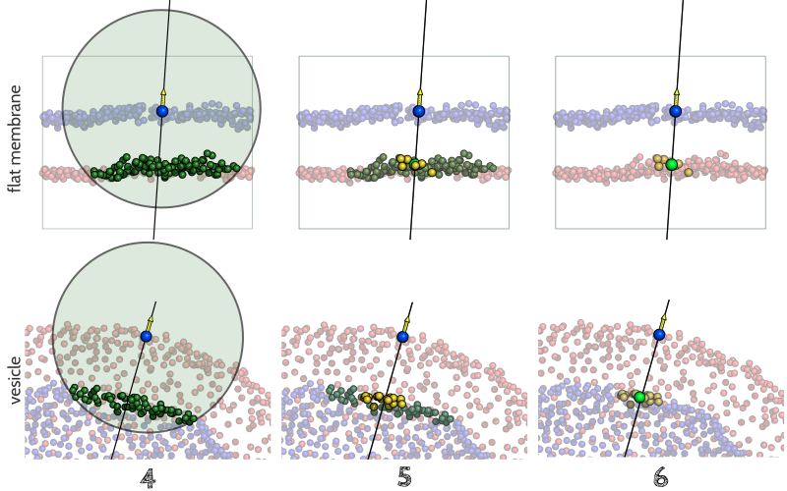
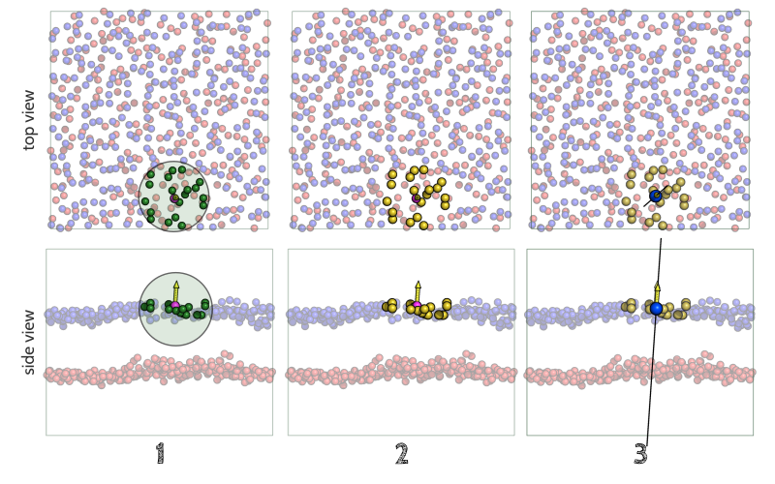
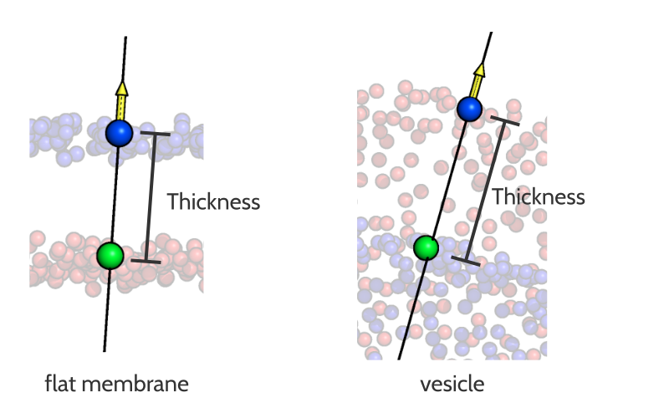
The software: FATSLiM
The membrane analyzer
Membrane thickness
$ fatslim thickness -c conf.gro -t traj.xtc -n index.ndx --plot-thickness thickness.xvg
https://pythonhosted.org/fatslim/documentation/thickness.html
23

Slide 27
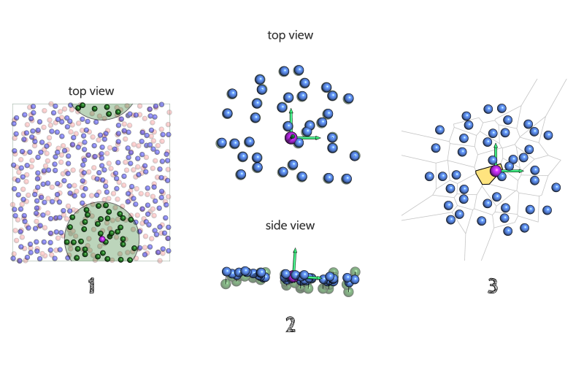
The software: FATSLiM
The membrane analyzer
Membrane thickness
Area per lipid (APL)
$ fatslim apl -c conf.gro -t traj.xtc -n index.ndx --plot-thickness thickness.xvg
https://pythonhosted.org/fatslim/documentation/apl.html
24

Slide 28
Today...
Membrane-only system
Just POPC
Membrane creation
Obtaining the parameters
Energy minimization + equilibration
Simulation
Membrane analysis
POPC+CHL
Comparative analysis
Protein-membrane system
CB₂ in a POPC+CHL membrane
PACKMOL-Memgen
FATSLiM
Force Fields:
Lipid14 for membrane
TIP3P for water
Amber14ILDN for protein
25

Slide 29

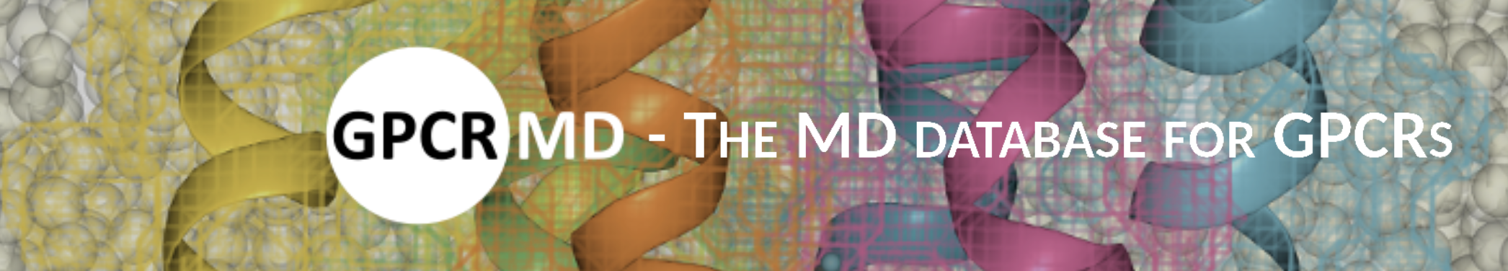
TO DO
1. Pick ONE simulation from an online repository:
http://www.charmm-gui.org/?doc=archive
http://gpcrmd.org/
2. Write a report (2 PAGES MAX!) with the analysis of:
Membrane thickness
APL
RMSD
RMSF
SS conservation
3. Send it to Nil.Casajuana@uab.cat with ”MD_membrane_env” as the Subject.
26

